Slide 1

DengAI: Predicting Disease Spread
03/07/2018
Final Project
Name: Young, Brent
DrivenData Name: bdy3176
Predict 413 Section #: 55
Quarter: Winter 2018
Notes:
Slide 1
Hi Everyone,
In the next few minutes I will be doing an overview of my results for the DengAI: Predicting Disease Spread final project.
First, I’ll do a quick EDA of the data and data preparation. I’ll then go into the types of models, formulation of the models, and then conclude with performance/accuracy.

Slide 2

Agenda
Descriptive Stats & Data Preparation
Data Exploration
Types of Models
Formulation of Models
Performance/Accuracy

Slide 3
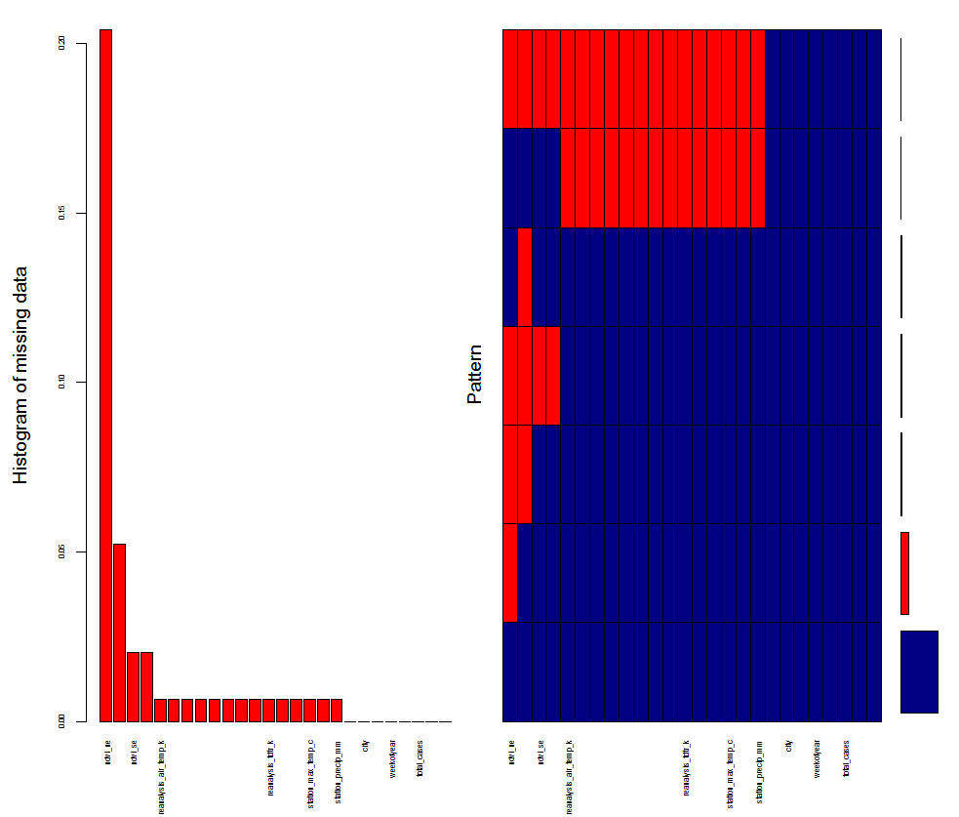
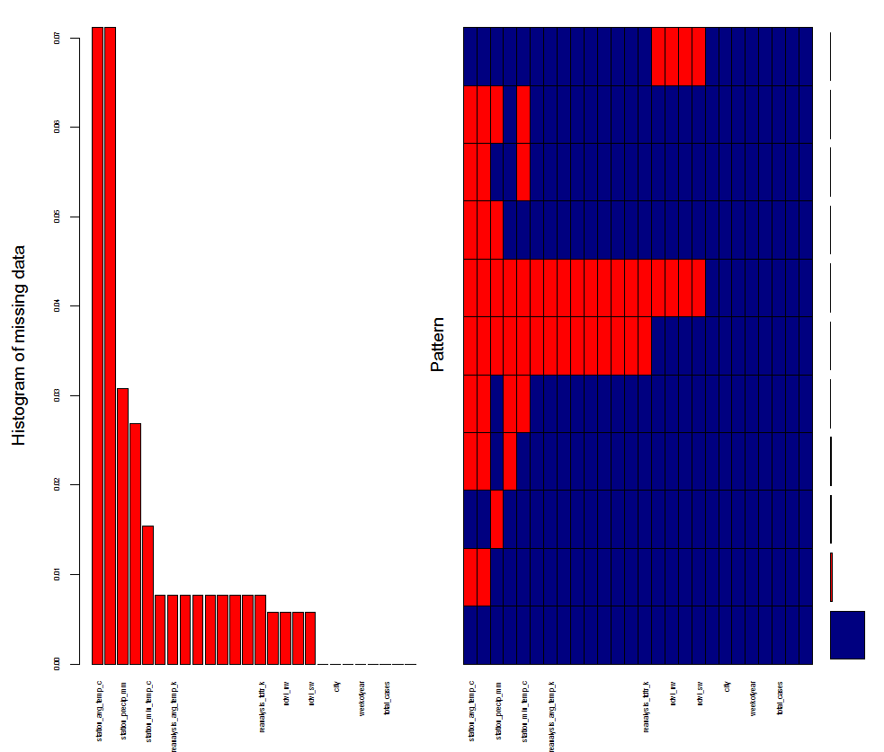
Descriptive Statistics & Data Preparation
Processing of Data: Combined all files (dengue_labels_train, dengue_features_train, and dengue_features_test) into one file called dengue_features_train_combined and separated the two cities into distinct datasets and timeseries.
Missing Values EDA
Overall, 641 NaN’s (excluding total_cases from test dataset): 522 NaN’s on training and 119 on test dataset
San Juan (train): 362 NaN’s
Iquitos (train): 160 NaN’s
Overall, 18 of the 20 environmental variables for San Juan & Iquitos have missing data on training dataset
Imputation Approach
Used Mice Package (method: “pmm” = predictive mean matching)

Slide 4
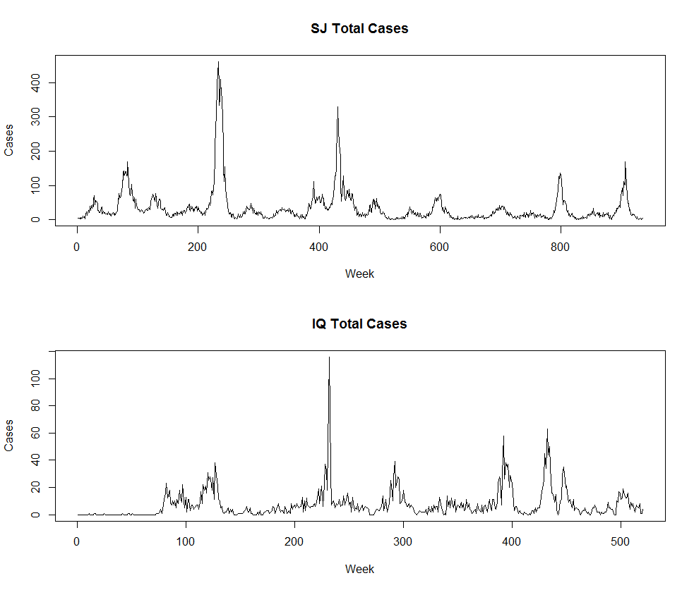
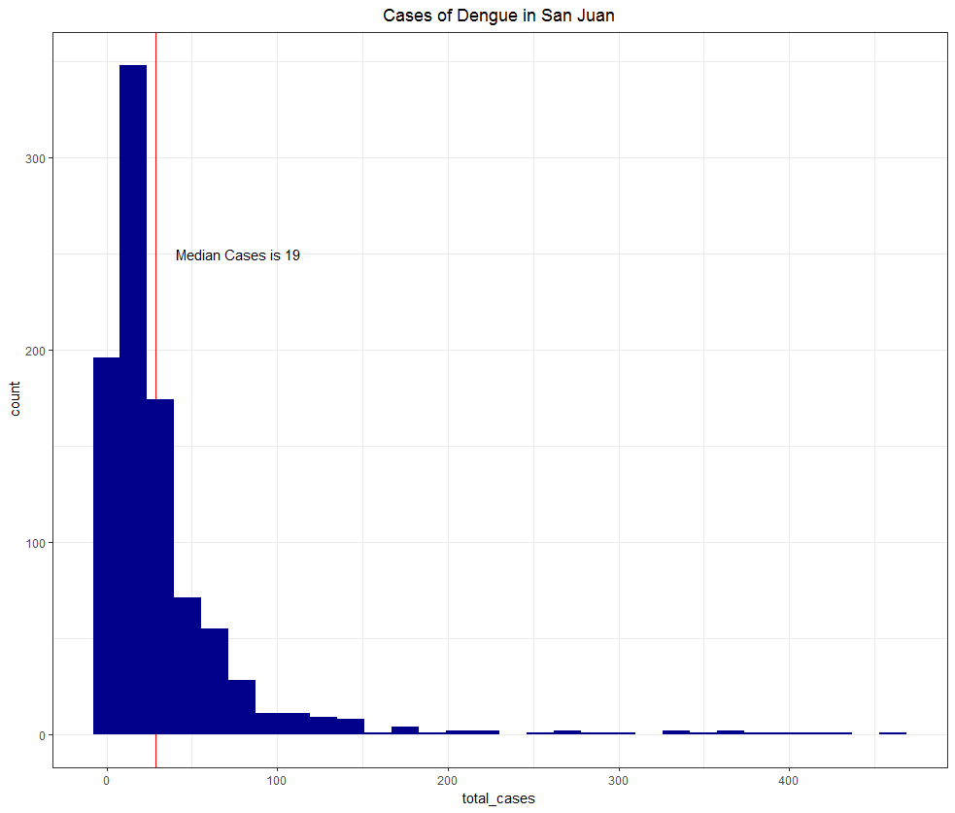
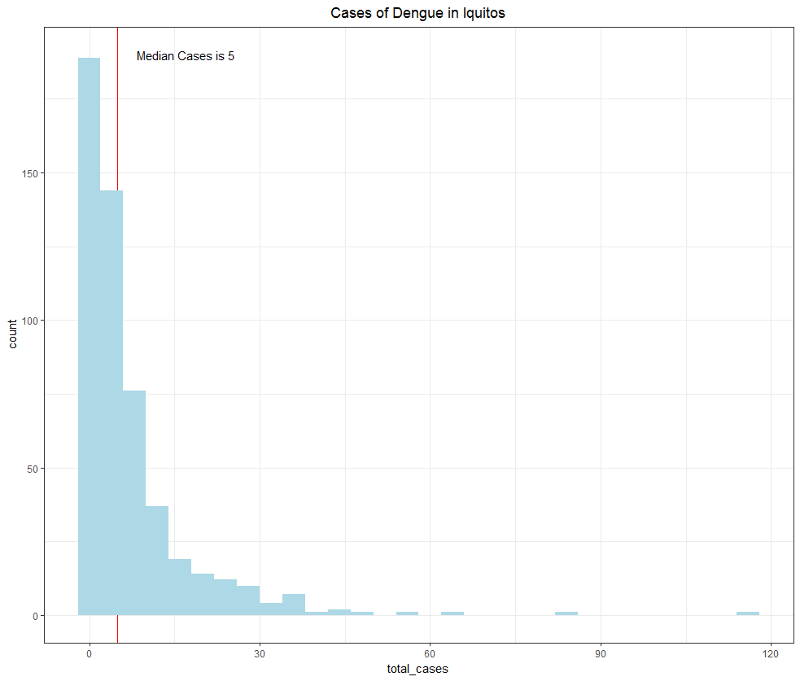
Data Visualization

Slide 5
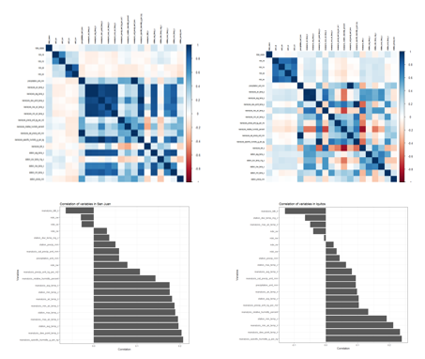
Correlation Plots
San Juan
Iquitos

Slide 6
Types of Models
ETS (auto)
Weights decay exponentially as the observations get older (e.g., more recent observation, the higher associated weight).
Useful since dengue is very contagious and the most recent values could be the most valuable
auto.arima with regressors
Useful given the environmental data/variables that were provided
Neutral Network with regressors (auto)
Ability to “learn” from past data and is robust to outliers, which is perfect in this situation given the volatility and random fluctuations/spikes in the data
Useful given the environmental data/variables that were provided

Slide 7
Formulation of Models
Approach
Train and test set:
San Juan
Train: First 675 observations
Test: Next 260 observations to mimic the period from week 18 of 2008 (4/29/2008) to week 17 of 2013 (4/23/2013)
Iquitos
Train: observations 937 to 1299
Test: Next 156 observations to mimic the period from week 26 of 2010 (7/2/2010) to week 26 of 2013 (6/25/2013)
Forecast each city using ETS, auto.arima, and neural network and then compare the results using performance/accuracy metrics.
The model that has the best scores will be used for final submission.

Slide 8
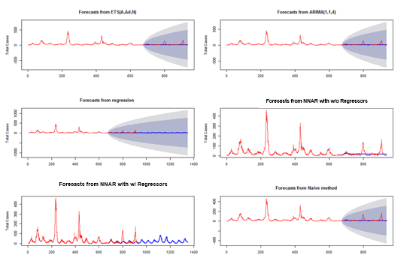
Performance/Accuracy for San Juan

Slide 9
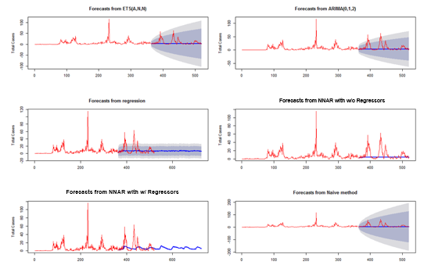
Performance/Accuracy for Iquitos

Slide 10
Performance/Accuracy
Final Submission

Slide 11
Thank you!

